Slide 1

Variability in
AI Training Inputs
Assessing the increase in compute and parameters over time
Kara Taylor
Descriptive Analysis Final Project
Data as of: October 1, 2026
Notes:
[Sources]
Background: AI-generated abstract artwork, created for this presentation.

Slide 2
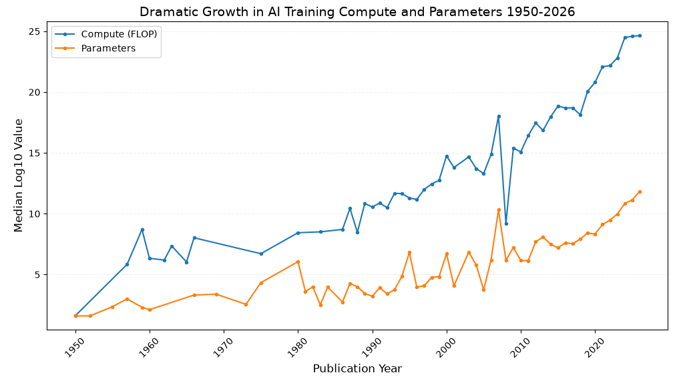

Fact:
AI training inputs such as compute and parameters have increased overtime.
Each step represents a tenfold increase
Notes:
Most compute: GPT-6 Astra (OpenAI), at about 1.0e27 FLOP (1 followed by 27 zeros or 1 octillion FLOPS)
Most Parameters: Grok 4 (xAI), at 3,000,000,000,000, or 3 trillion parameters or 3e12.

Slide 3
Question:
Does the timing and rate of increase differ by category?
Yes
Data Measures
Training Compute:
  Total calculations used to train
  Measured as a count of floating-point operations (FLOP)
Parameters:
  Number of adjustable values learned during training
  Indicator of model size
Categories of Interest
Organization
  Which company is growing fastest?
Organization Category
  Does Industry have higher measure than Academia?
Country of Organization
  Is China keeping pace with the US?
Meta AI
Industry
Indeterminant
Both measure training inputs, performance is a separate question.
Notes:
Since 2020, Meta has increased it’s compute on average 12 times per year. Twice as fast as any other Category.
Industry has higher fitted compute and parameters every from 2020 on

Slide 4
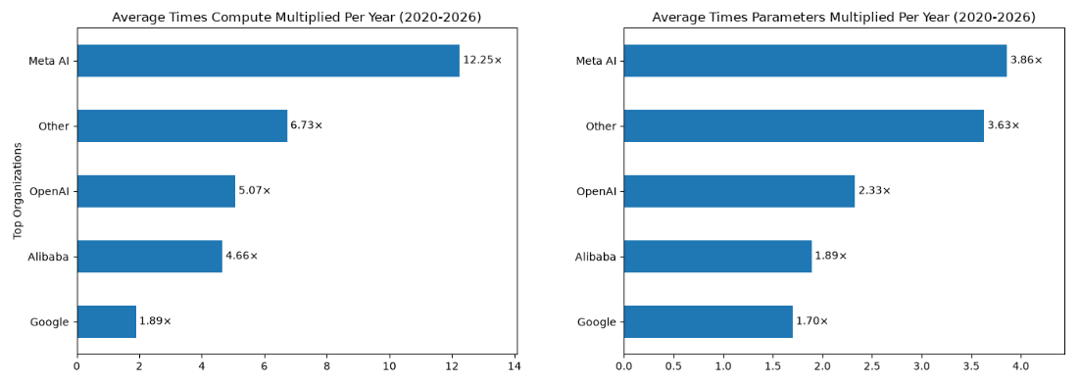
Insight: Meta’s rate of increase stood out
Available Data | Compute | Parameters
Meta | 28 of 42 (67%) | 32 of 42 (76%)
Open AI | 17 of 71 (24%) | 18 of 71 (25%)
Low data availability limits confidence in how representative Open AI’s growth is
Notes:
Number of organization in “Other” xAI, Antropic, Cursor on their own not enough data

Slide 5
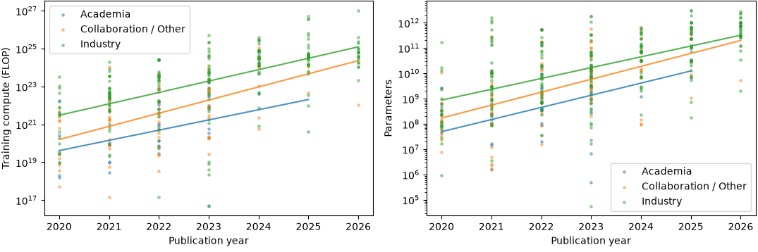
Insight: Industry input levels above Academia
Available Data | Compute | Parameters
Academia | 34 of 58 (59%) | 45 of 58 (78%)
Industry | 211 of 451 (47%) | 279 of 451 (62%)
Academia has slightly higher availability; growth rate were broadly similar

Slide 6
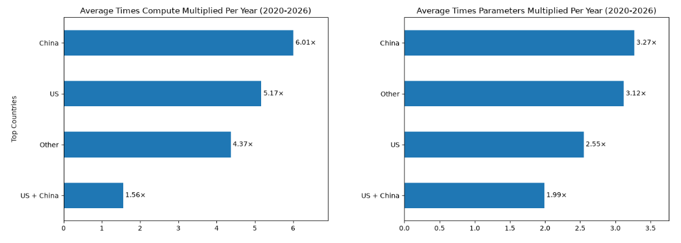
Insight: China’s recent growth appears faster
Growth comparisons depend on time period
For Compute…
  China had statistically faster growth for 2010-2026
  China had faster growth for 2020-2026
  US had faster growth for 2022-2026
For Parameters…
  China had faster growth in every tested period
  Statistically significant for start years 2010, 2018, 2022
Bottom-line: Unable to assert if US or China is growing faster
Available Data | Compute | Parameters
China | 80 of 141 (57%) | 117 of 141 (83%)
US | 195 of 397 (49%) | 242 of 397 (61%)

Slide 7
Dataset Overview:
Epoch AI’s notable models
Frontier (138)
Large-Scale
(532)
Notable
(1,078)
All Models
(3620)
Data range 1950-2026, most published since 2020
Category fields allowed multiple selections
  Removed repeated values and created summary level groupings
  Identified categories with most models combined all others
  US + any other country as US, same for China, US + China separate
Field | Unique Values | Remove Repeats | Final
Organization | 443 | Not applied | 5
Organization Category | 48 | 12 | 3
Country of Organization | 149 | 81 | 4
Notes:
Organizations
Meta AI
Google
Alibaba
Open AI
Other
Category
Academia
Industry
Collaboration / Other
Country
China
US
US + China
Other

Slide 8
Limitations:
Data availability / Incomplete reporting is biggest limitation
  Missing data may introduce selection bias
  Available models may not be representative of missing data
  Small sample size reduces how accurately data represents a category
Epoch notes some values may be estimates, analysis did not consider ‘confidence’ rating
Grouping decisions limit detailed comparisons and affect ranking
Observations based on fitted trends without complete statistical testing
Significant Limitations raise doubt on categorical comparisons of growth rate

Slide 9
Conclusions and Next Steps
Conclusions
  US and China go back and forth on compute growth rate
  China has faster parameter growth rate in all tested years
  Meta stands out in rate of increase
  Industry retains higher levels over Academia
  Data availability rates cast doubt on nearly all results
Next Steps
  Consider Confidence of available data and statistical testing
  My next Question: Do larger inputs improve performance
    Pull in Epoch benchmark data
    If correlation between data inputs and benchmarks,
    Then input growth → predict next best models
Training inputs are increasing… faster for some … but does it improve performance?

